Slide 1
System models

Slide 2
Topics covered
Context Models
Process Models
Behavioural Models
  State Machine
  Data flow Model
Semantic Data Models

Slide 3
System Modelling
System modelling helps the analyst to understand the functionality of the system and models are used to communicate with customers.
Different models present the system from different perspectives
  External perspective showing the system’s context or environment;
  Behavioural perspective showing the behaviour of the system;
  Structural perspective showing the system or data architecture.

Slide 4
Model Types
Data processing model showing how the data is processed at different stages.
Composition model showing how entities are composed of other entities.
Architectural model showing principal sub-systems.
Classification model showing how entities have common characteristics.
Stimulus/response model showing the system’s reaction to events.

Slide 5
Context models
Context models are used to illustrate the operational context of a system - they show what lies outside the system boundaries.
Social and organisational concerns may affect the decision on where to position system boundaries.
Architectural models show the system and its relationship with other systems.

Slide 6
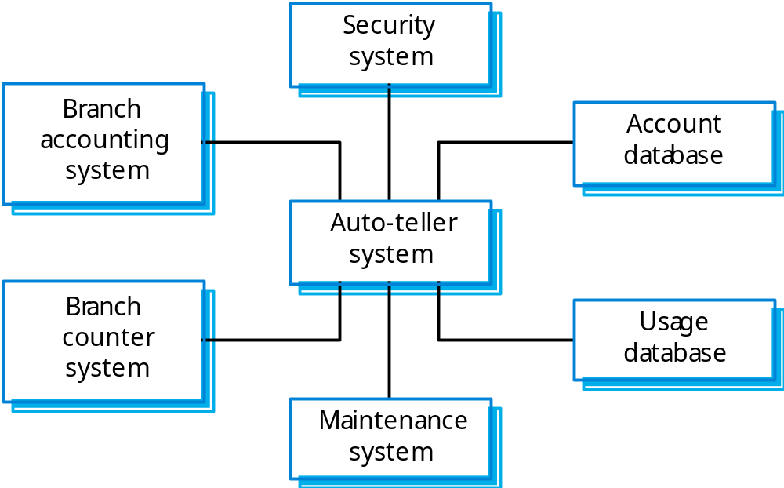
The context of an ATM system

Slide 7
Process models
Process models show the overall process and the processes that are supported by the system.
Data flow models may be used to show the processes and the flow of information from one process to another.

Slide 8
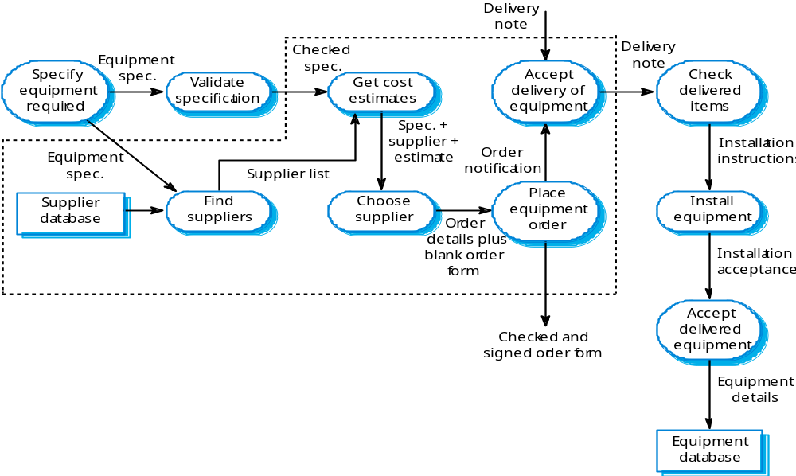
Equipment procurement process

Slide 9
Behavioural models
Behavioural models are used to describe the overall behaviour of a system.
Two types of behavioural model are:
  Data processing models that show how data is processed as it moves through the system;
  State machine models that show the systems response to events.
These models show different perspectives so both of them are required to describe the system’s behaviour.

Slide 10
State machine models
These model the behaviour of the system in response to external and internal events.
They show the system’s responses to stimuli so are often used for modelling real-time systems.
State machine models show system states as nodes and events as arcs between these nodes. When an event occurs, the system moves from one state to another.
Statecharts are an integral part of the UML and are used to represent state machine models.

Slide 11
State Transition Diagram
The State Transition Diagram (also called State Diagram, State chart Diagram) shows the life history for objects of a given class, the events that cause a transition from one state to another for those objects, and the actions of the object that result from a state change. They are created for classes whose objects exhibit ‘significant’ dynamic behavior.

Slide 12
Initial and Final States
The initial (or start) state is the default starting place for a state machine.
The (optional) final (or end) state indicates the completion of the state machine’s execution.
Notes:
The initial state (or start state) symbol is represented by a large black circle. Its label usually contains initial conditions. A transition line is drawn from the initial state symbol to the next state.
The final state (or stop state) symbol is represented by a circle surrounding a bullet. The final state symbol’s label generally indicates final conditions. You can draw transition lines to it from.

Slide 13
Example:
State Transitions For an Order
Event
[not all items checked]
/ get next item
Item received [some
items not in stock]
Action
[All items checked && some
/ get first item
Checking
items not in stock]
Waiting
do: check item
Transition
[All items checked &&
Activity
Item received [all items
all items available]
available]
Guard
State
Dispatching
delivered
Delivered
do: initiate delivery
Notes:
These examples begin on Fowler and Scott (second edition), page 119.
As previously mentioned, state diagrams describe all of the possible states that a particular object can get into and how the object’s state changes as a result of events that reach the object. Usually, state diagrams are drawn for a single class to show the lifetime behavior of a single object.
The example above shows a UML state transition diagram for an order processing system. The diagram indicates the various states of an order.
Beginning at the start state, we show an action triggering an initial transition into the Checking state. This transition is labeled “/get first item.” Note: usually event triggers are not permitted with the start state.
The syntax for the transition labels has three (or four) parts, all of which are optional: Event (arguments) [Guard Condition] / Action. In this case, we only have the action, “get first item.” Once we perform that action, we enter the Checking state. The Checking state has an activity associated with it, indicated by the label with the syntax do/activity. In this case, the activity is called “check item.”

Slide 14
Example:
State Transitions For an Order
The diagram indicates the various states of an order.
Beginning at the start state, we show an action triggering an initial transition into the Checking state. This transition is labeled “/get first item.” Note: usually event triggers are not permitted with the start state.
The syntax for the transition labels has three (or four) parts, all of which are optional: Event (arguments) [Guard Condition] / Action. In this case, we only have the action, “get first item.” Once we perform that action, we enter the Checking state. The Checking state has an activity associated with it, indicated by the label with the syntax do/activity. In this case, the activity is called “check item.”

Slide 15
Example Problem:
Cancel the Order
Want to be able to cancel an order at any time
Solutions
  Transitions from every state to state “cancelled”

Slide 16
Example:
Transitions to “cancelled”
[ not all items checked ]
/ get next item
Item received [some
items not in stock ]
[All items checked &&
/ get first item
Checking
some items not in stock]
do: check
item
Waiting
Item received [all
[ All items checked &&
items available]
all items available]
cancelled
cancelled
Dispatching
do: initiate delivery
cancelled
Cancelled
delivered
Delivered
Notes:
Even with only three duplicated transitions, this state transition diagram looks very cluttered. In this case, it is clearer to show this state transition behavior using super- and substates (next slide).

Slide 17
Example:
Superstate / Substates
Active
[not all items checked]
/ get next item
Item received [some
items not in stock]
[ All items checked && some
/ get first item
Checking
items not in stock ]
Waiting
do: check
item
cancelled
Cancelled
[All items checked &&
Item received [all
all items available]
items available]
Dispatching
delivered
do: initiate delivery
Delivered
Notes:
Example page 123 Fowler (second edition).

Slide 18
Example:
Payment Authorization
2 parallel processes:
- authorization
- order handling
Authorizing
[ payment not ok ]
do: check payment
[ payment ok ]
Authorized
Rejected
Delivered
Notes:
In addition to states of an order that are based on the availability of the items, there are also states that are based on payment authorization. If we look at these states, we might see a state diagram like the Payment Authorization diagram above.
Here we begin by doing an authorization, The “check payment” activity finishes by signaling that the payment is approved. If the payment is OK, the given order waits in the Authorized state until the “deliver” event occurs. Otherwise, the order enters the Rejected state.
In this case, the Order object exhibits a combination of the behaviors shown in the firs two examples (two slides back and four slides back). These associated states and the cancelled state discussed earlier can be combined on a concurrent state diagram (see next slide).

Slide 19
Example:
Payment Authorization
In addition to states of an order that are based on the availability of the items, there are also states that are based on payment authorization. If we look at these states, we might see a state diagram like the Payment Authorization diagram above.
Here we begin by doing an authorization, The “check payment” activity finishes by signaling that the payment is approved. If the payment is OK, the given order waits in the Authorized state until the “deliver” event occurs. Otherwise, the order enters the Rejected state.
In this case, the Order object exhibits a combination of the behaviors shown in the firs two examples (two slides back and four slides back). These associated states and the cancelled state discussed earlier can be combined on a concurrent state diagram (see next slide).

Slide 20
Data-processing models
Data flow diagrams (DFDs) may be used to model the system’s data processing.
These show the processing steps as data flows through a system.
DFDs are an intrinsic part of many analysis methods.
Simple and intuitive notation that customers can understand.
Show end-to-end processing of data.

Slide 21
Data flow diagrams
DFDs model the system from a functional perspective.
Tracking and documenting how the data associated with a process is helpful to develop an overall understanding of the system.
Data flow diagrams may also be used in showing the data exchange between a system and other systems in its environment.

Slide 22
The Flow Model
Every computer-based system is an
information transform ....
computer
based
system
input
output

Slide 23
Flow Modeling Notation
external entity
process
data flow
data store

Slide 24
External Entity
A producer or consumer of data
Examples: a person, a device, a sensor
Another example: computer-based
system
Data must always originate somewhere
and must always be sent to something

Slide 25
Process
A data transformer (changes input to output)
Examples: compute taxes, determine area,
format report, display graph
Data must always be processed in some
way to achieve system function

Slide 26
Data Flow
Data flows through a system, beginning
as input and be transformed into output.
base
compute
triangle
area
area
height

Slide 27
Data Stores
Data is often stored for later use.

Slide 28
Data Flow Diagramming Guidelines
All icons must be labeled with meaningful names
The DFD evolves through a number of levels of detail
Always begin with a context level diagram (also called level 0)
Always show external entities at level 0
Always label data flow arrows

Slide 29
Level 0 DFD Example
processing
request
user
requested
video
signal
digital
video
processor
monitor
video
source
video signal

Slide 30
The Data Flow Hierarchy
a
b
x
P
y
level 0
a
c
p2
f
p1
p4
b
d
5
p3
e
g
level 1

Slide 31
Level-0 DFD / context diagram
This highest level DFD represents the system as a whole.
Financial Gateway
Traveler
Financial Data
Railway reservation
System
Reservation Cancellation Enquiry etc.
Data
Travel Agent
IVR
Reservation, cancellation, enquiry, concessions etc
Backup, Recovery, and Admin commands
System Admin
Clerk

Slide 32
Level-1 DFD
Reservation system
Financial Gateway
Traveler
Reservation
Cancellation
Enquiry
Reservation & Train data
Travel Agent
Clerk
System Admin
IVR

Slide 33
Level-2 DFD
Check Balance
Travel details
Verify data
Traveler
Fare amount, Account no
Train code, Date of journey etc.
Verify availability
Financial Gateway
Data Store
Make reservation

Slide 34
Quiz Software Example : Level 0
Quiz Software
Submit Answers
Student
Feedback
Correct/Incorrect

Slide 35
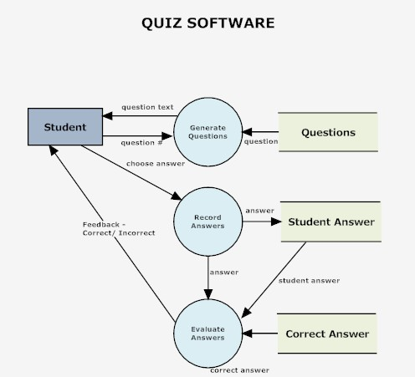
Level 1

Slide 36
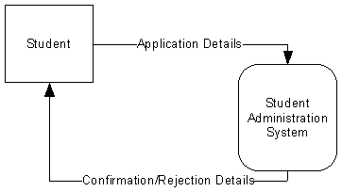
Student Admission Example
Level 0
In this case:
External entity - Student
Process - Student Administration process application
Data Flows - Application Form, Confirmation/Rejection Letter

Slide 37
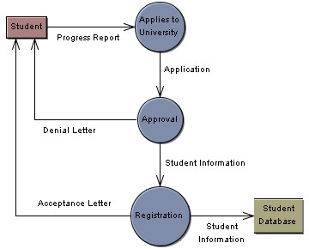
Level 1 Data Flow Diagram

Slide 38
Semantic data models
Used to describe the logical structure of data processed by the system.
An entity-relation-attribute model sets out the entities in the system, the relationships between these entities and the entity attributes
Widely used in database design. Can readily be implemented using relational databases.
No specific notation provided in the UML but objects and associations can be used.

Slide 39
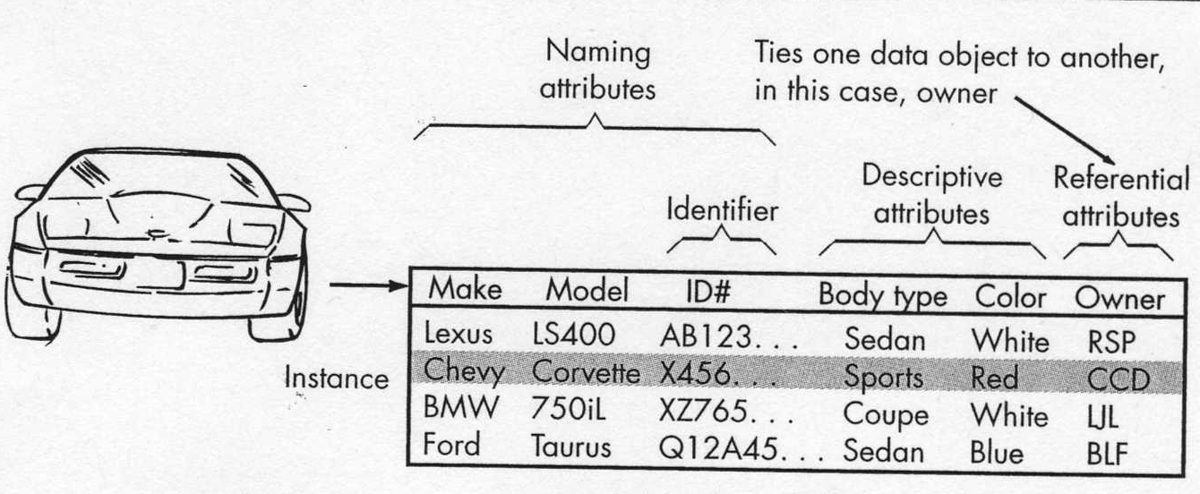
DATA MODELING CONCEPTS

Slide 40
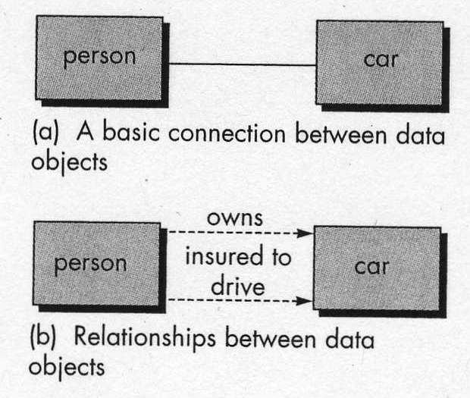
DATA MODELING CONCEPTS
Attributes
Data attributes define properties of a data object.
RELATIONSHIPS
Data objects connect to one another in different ways.

Slide 41
DATA MODELING CONCEPTS
RELATIONSHIPS CARDINALITY
We must understand the number of occurrences an object has related to another object.
Cardinality is the specification of the number of occurrences of one object that can be related to the number of occurrences of another object.
1 : 1 relationship – one object can relate to only another object.
1 : N relationship – one object can relate to many objects.
M : N relationship – a number of occurrences of an object can relate to many objects

Slide 42
ERD Notation
One common form:
(0, m)
object
relationship
object
1
(1, 1)
2
attribute
Another common form:
object
relationship
object
1
2
(0, m)
(1, 1)

Slide 43
Building an ERD
Level 1—model all data objects (entities) and their “connections” to one another
Level 2—model all entities and relationships
Level 3—model all entities, relationships, and the attributes that provide further depth

Slide 44
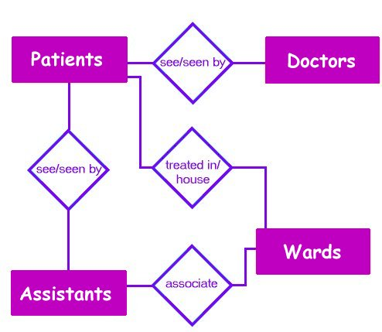
The ERD: An Example

Slide 45
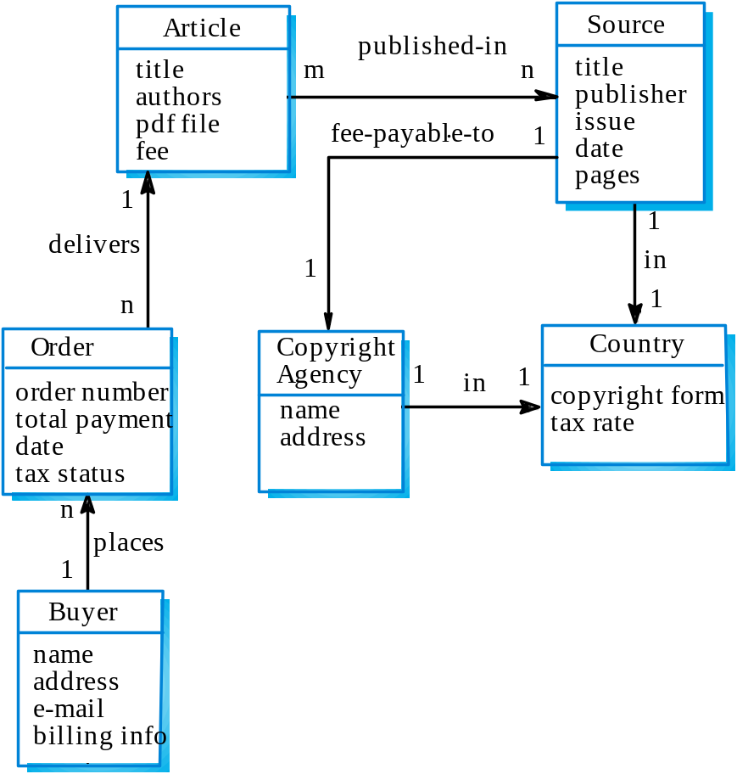
Library semantic model

Slide 46
Data dictionaries
Data dictionaries are lists of all of the names used in the system models. Descriptions of the entities, relationships and attributes are also included.
Advantages
  Support name management and avoid duplication;
  Store of organisational knowledge linking analysis, design and implementation;
Many CASE workbenches support data dictionaries.

Slide 47
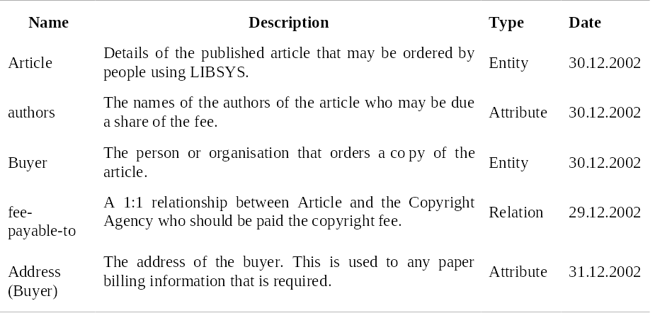
Data dictionary entries

